Slide 1


Using machine learning to assist in the aftershock analysis and geologic interpretation for three separate earthquake sequences
Spencer Wilbur
Notes:
Identify your committee members if Dylan forgets in his introduction.
Thank the audience for coming to your proposal defense.

Slide 2

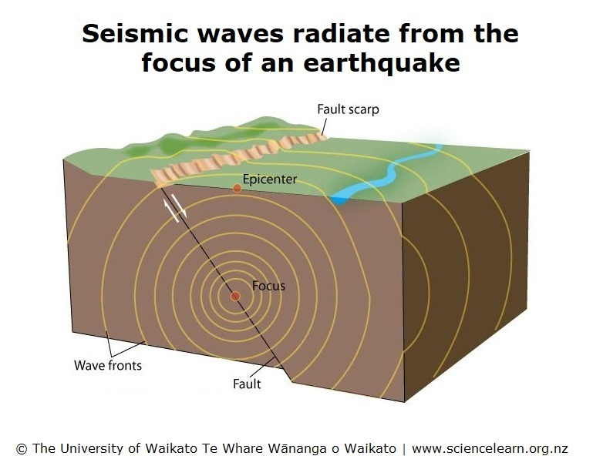
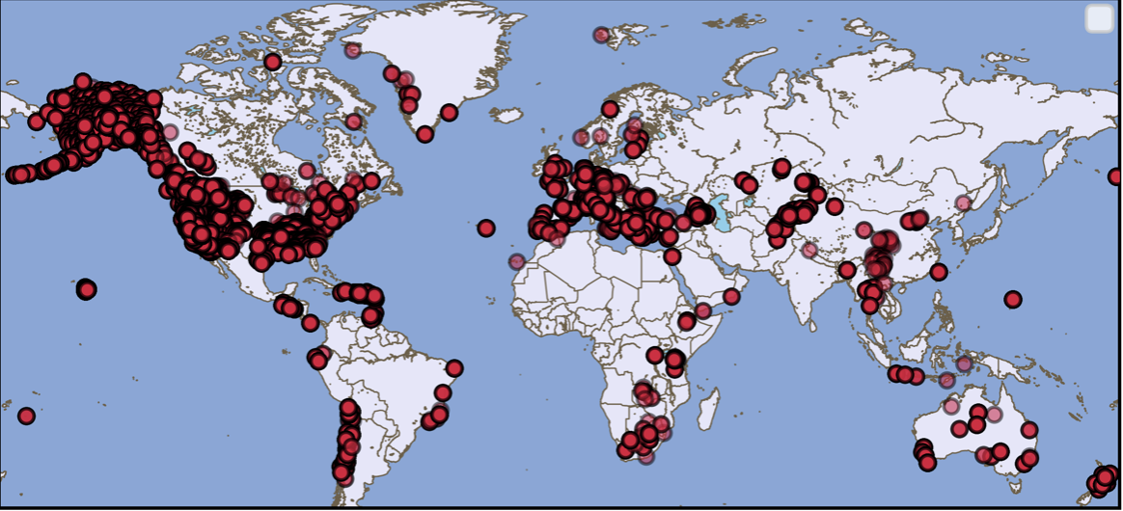
Introduction
EQTransformer is an AI-based earthquake signal detector and phase (P&S) picker based on a deep neural network with an attention mechanism
The algorithm is designed in python and is modeled using the STanford EArthquake Dataset (STEAD)
STEAD is a large-scale global dataset of labeled earthquake and non-earthquake signals (Mousavi, 2019)
Figure: University of Waikato Te Whare Wananga o Waikato, 2007
Geohazard: A geohazard is a geological state that may lead to widespread damage or risk. Geohazards are geological and environmental conditions and involve long-term or short-term geological processes. (International Centre for Geohazards, 2008)

Slide 3
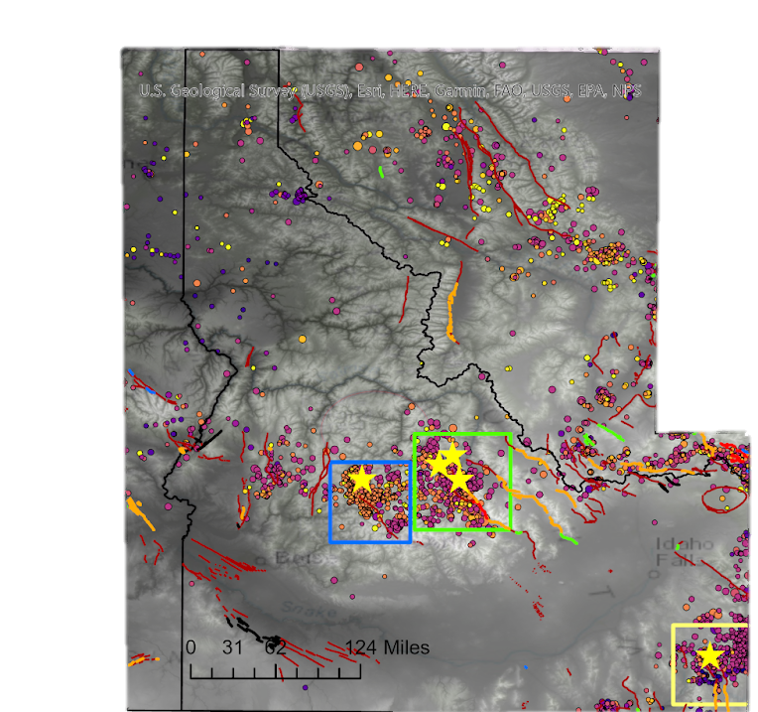
The Stanley Idaho Earthquake took place on March 31st , 2020 in the remote Sawtooth Wilderness of Central Idaho.
The Sulphur Sequence began on September 2nd , 2017 and continued until the end of October 2017.
The Challis sequence began in April of 2014 and was followed by an energetic sequence of aftershocks then tapered off until another energetic sequence began in early 2015.
Notes:
Map containing USGS events for the Three sequences I am studying based on depth
The Sawtooth fault is an eastern dipping normal fault that trends to the Northwest.
The Sulphur peak sequence occurred along a northwest trending eastern dipping normal fault as well.
The sequence of events was observed until May of 2017. The Challis sequence occurred along the Lost river fault, an east dipping normal fault.

Slide 4
Goals of the Project
Determine driving mechanisms for these sequences: Is the crustal stress tectonically induced or fluid-driven?
Determine whether there is any interplay between the northwest trending Sawtooth Fault and the Trans-Challis Fault System related to Basin and Range extension?
Locate any unmapped faults in the subsurface related to the initiation of rupturing events?
Determine the depth of the seismogenic zone for these three sequences.

Slide 5
Methods
Using the temporary arrays and hand-picked catalogs I compared the machine learning located events and phase picks to the original catalogs.
EQTransformer’s phase files were the input for a relocation algorithm called Hypoinverse.
Hypoinverse helps assess the quality the picks within the phase file using a rating of “A, B, C, or D”
The scope of this research involves assessing the data in way so that we can gauge the effectiveness of the machine learning algorithm before solely relying on its picks and detection methods.
This is a general flow for this process:
Use EQTransformer Algorithm on Stanley’s seismic data set
Assess the Quality of these picks using Hypoinverse’s quality rating
Compare the phase arrival picks of EQTransformer to manual picks
Repeat this process for Sulphur and Challis Sequence
Notes:
Here are the steps. Please update your bullets and putting things in order of the process. Your third bullet that starts with “Prior to a revised…” should be the first bullet.
Pick the P and S waves at all INL and XP network stations. (Pick the data for the events that are already in the USGS catalog. These are thus events that already have locations…we are just adding new P and S wave arrival times from these extra stations.)
Use Hyponiverse to relocate all of the events in steps 1. This estimates the hypocenter using the new arrival time data from the INL and XP stations. This also estimates all parameters (lat,lon,t0), not just depth. So don’t focus on just revised depths. You should focus on “revised hypocenters”. (Note: You may want to make an intro slide on picking P and S wave and the hypocenter estimation that results from those data. That would give the audience the background needed to follow all of the terms you are using.) From these parameters (e.g. lat/lon) you can compute revised epicentral distances, etc.
Relocate all of these events using hypoDD, which is double difference hypocenter relocation. The easiest way to explain this step is that is adds a clustering step to identify similar events and improves relative event location, but not absolute event location
In a completely separate analysis, we introduce EQTransformer. We don’t any of the USGS event information or Seisan event information. We simply put the continuously recorded data into EQTransformer and that code 1) identifies potential aftershocks and 2) picks the P and S wave arrival times.
We then repeat the steps above…i.e. use hypoinverse to locate all of the potential aftershocks that EQTransformer identified. Your next task is to do some QC on those aftershocks (e.g. check the travel time residual and decide if that is a real aftershock or if EQTransformer identified something that was not an aftershock.
(Note: Part of the QC process is to compare the EQTransformer picks to our Seisan picks, but that is just to convince ourselves that EQTransformer is doing a good job to pick accurate P and S wave arrival times.)
Lastly, we are not updating the USGS catalog with our manual picks. We are making a completely new catalog. It is rather semantic, but that is the correct way to state this. We are not updating the USGS catalog. We will publish our own ”new” catalog at the end of your thesis.

Slide 6
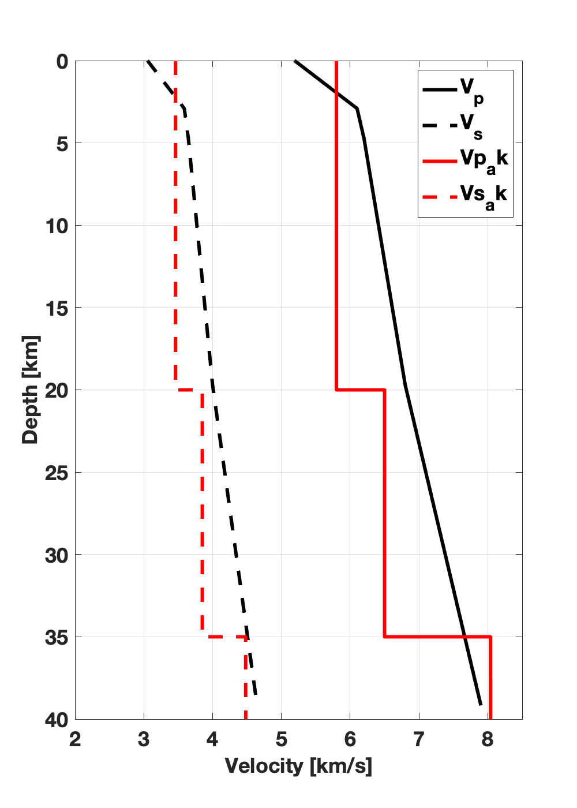
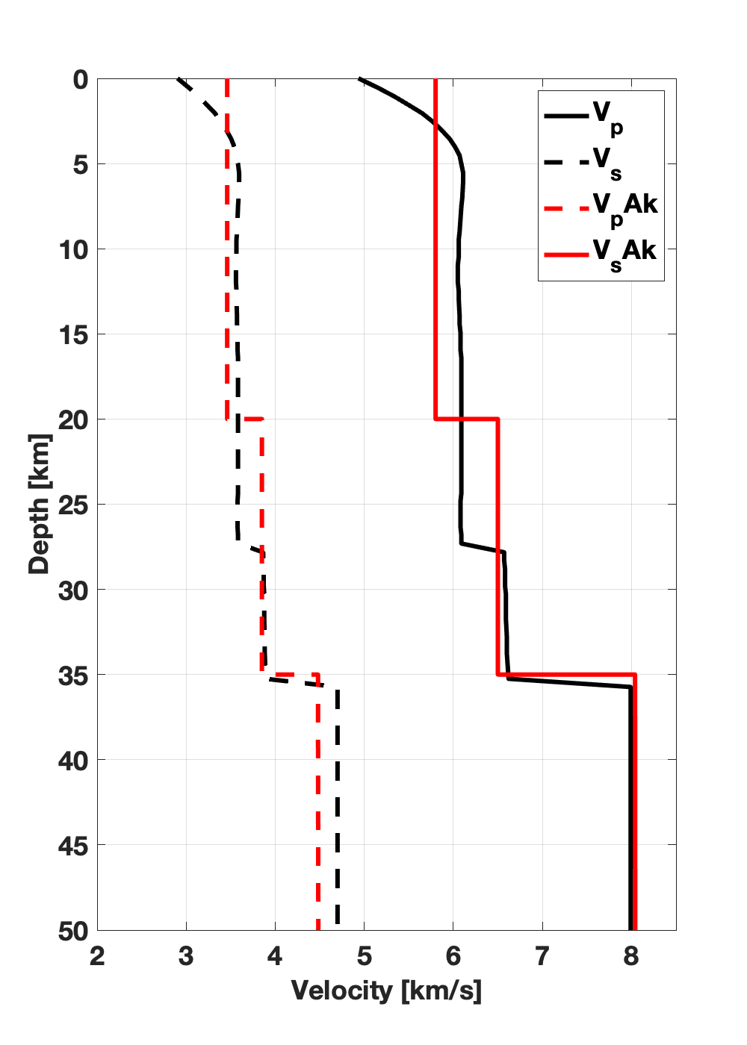
Which Velocity Model?
Sulphur vs. AK-135
Stanley vs. AK-135
The USGS catalogs utilized a velocity model called AK-135 when determining hypocenter event locations.
To assist in the quality of our picks we used update velocity model for each sequence.
AK135 velocity model (red) retrieved from IRIS DMC Data Products (Trabant et al., 2012), made available by research completed by Kennett, et al. (1995). The velocity model differences are only in the crust.

Slide 7
Parameter Table to Assist in Velocity Model Comparison
 | Number of Events | Number of A | Number of B | Number of C | Number of D
Stanley (AK_135 Velocity) | 74672 | 7159 | 31740 | 14465 | 21308
Stanley (Sawtooth Velocity) | 74670 | 2022 | 24556 | 21664 | 26428
Sulphur (Sulphur Velocity) | 2886 | 30 | 1520 | 868 | 468
Sulphur (AK- Velocity) | 2886 | 32 | 1568 | 871 | 415

Slide 8
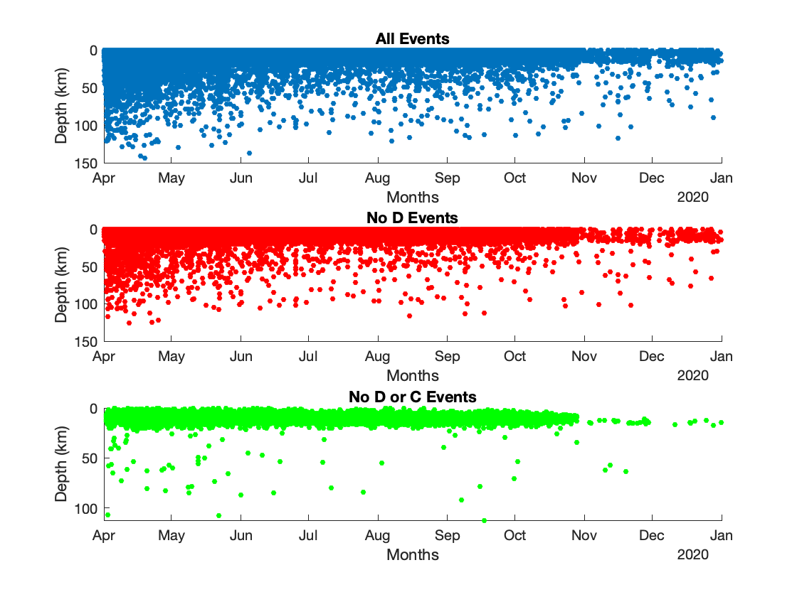
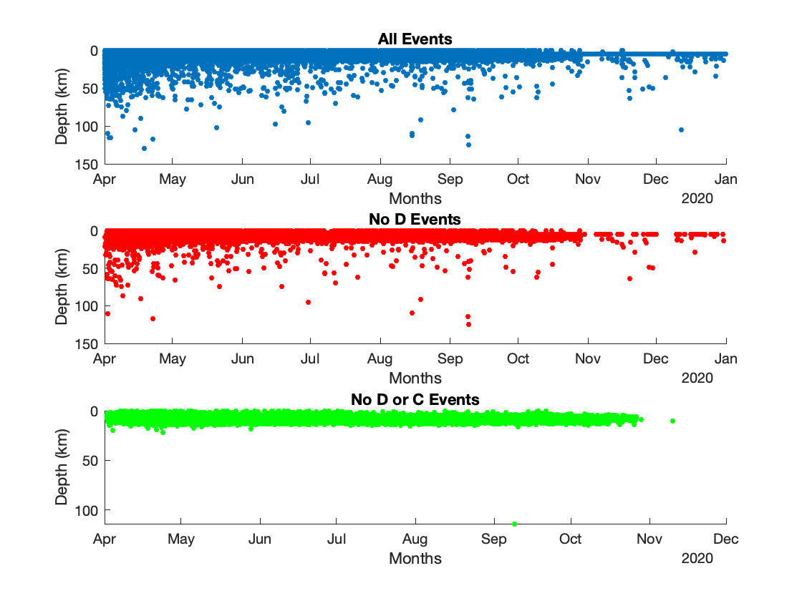
Compare the Velocity Models based on Depth for the Stanley Sequence
AK-135 Velocity Model
Sawtooth Velocity Model
Notes:
Explain the plots
Notice that the residuals are low for the Sawtooth Velocity Model and that even once the D’s and c’s are removed from the AK-135 picks we still see a decent amount of events detected at depths much greater than we’d expect

Slide 9
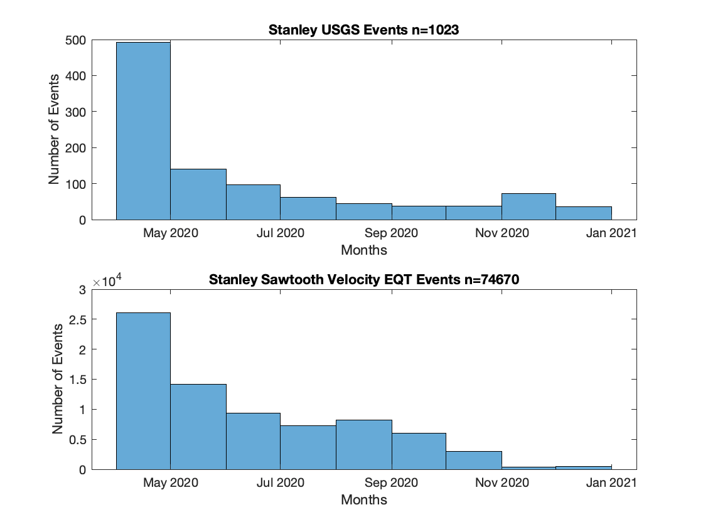
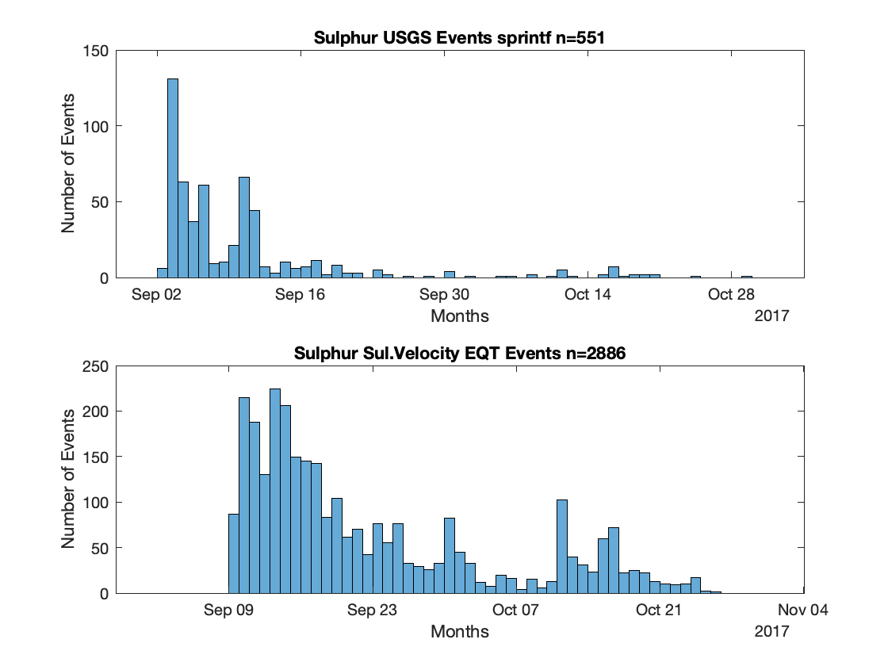

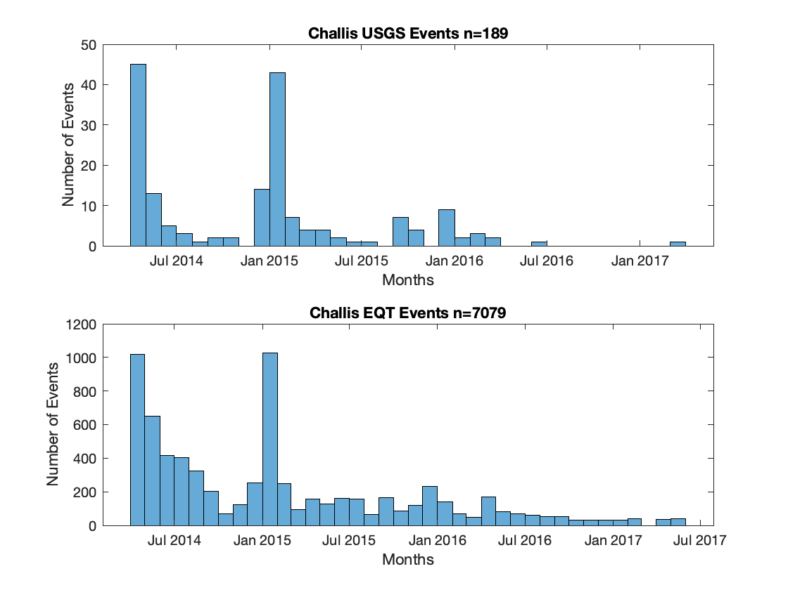

EQTransformer Total Events for Each Sequence
Notes:
Explain the dates and point out the energetic sequence's for Challis and the regional station deployement for sulphur, grab the dates for the the deployement of those stations and explain the causation for the lag from the 2nd to 9th of September
Explain the drop of in EQT events at the end of October due to the temporary station being retrieved from the field

Slide 10
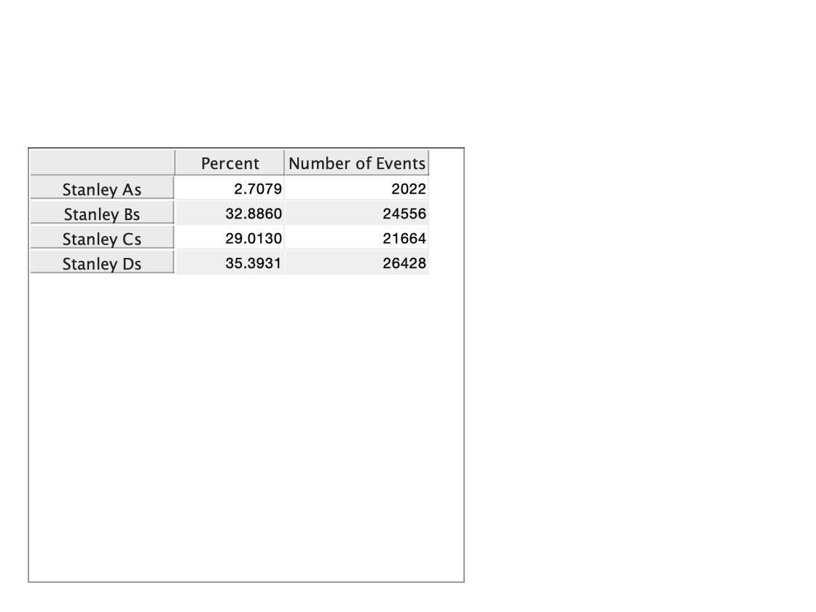
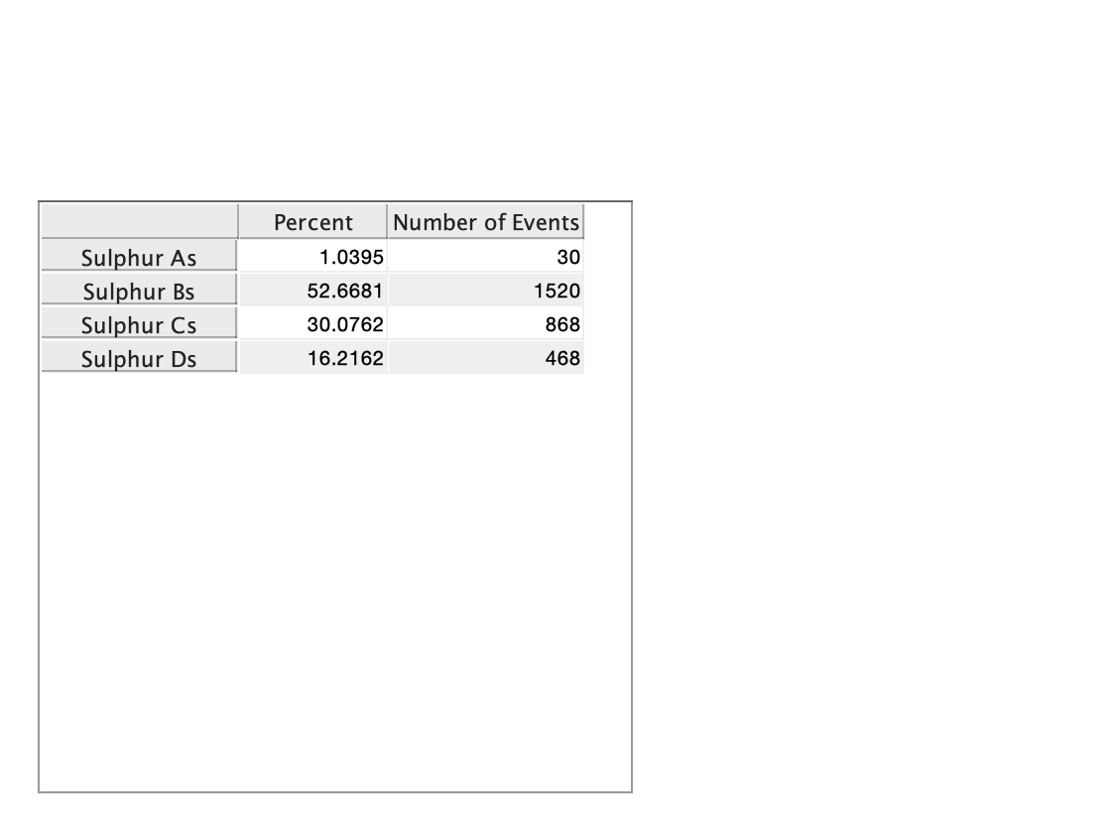

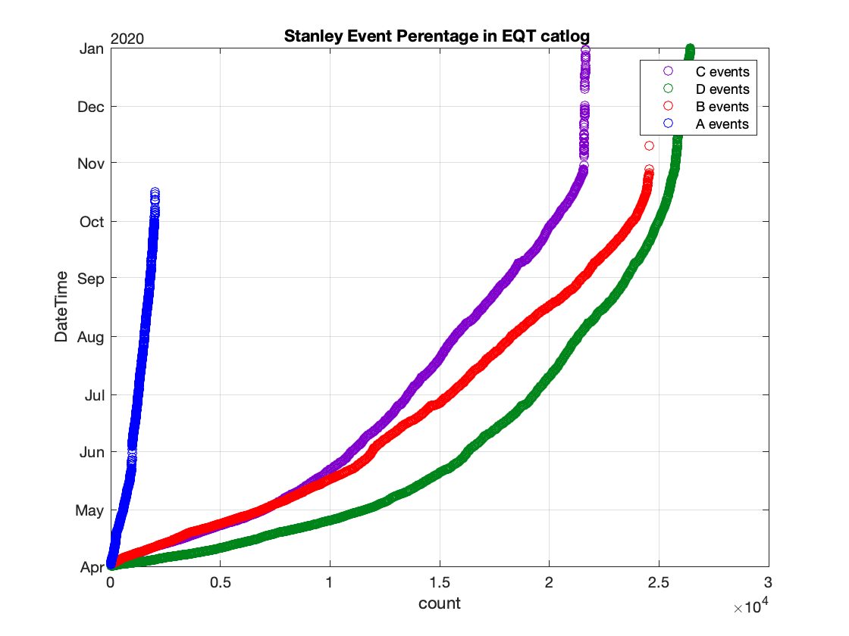
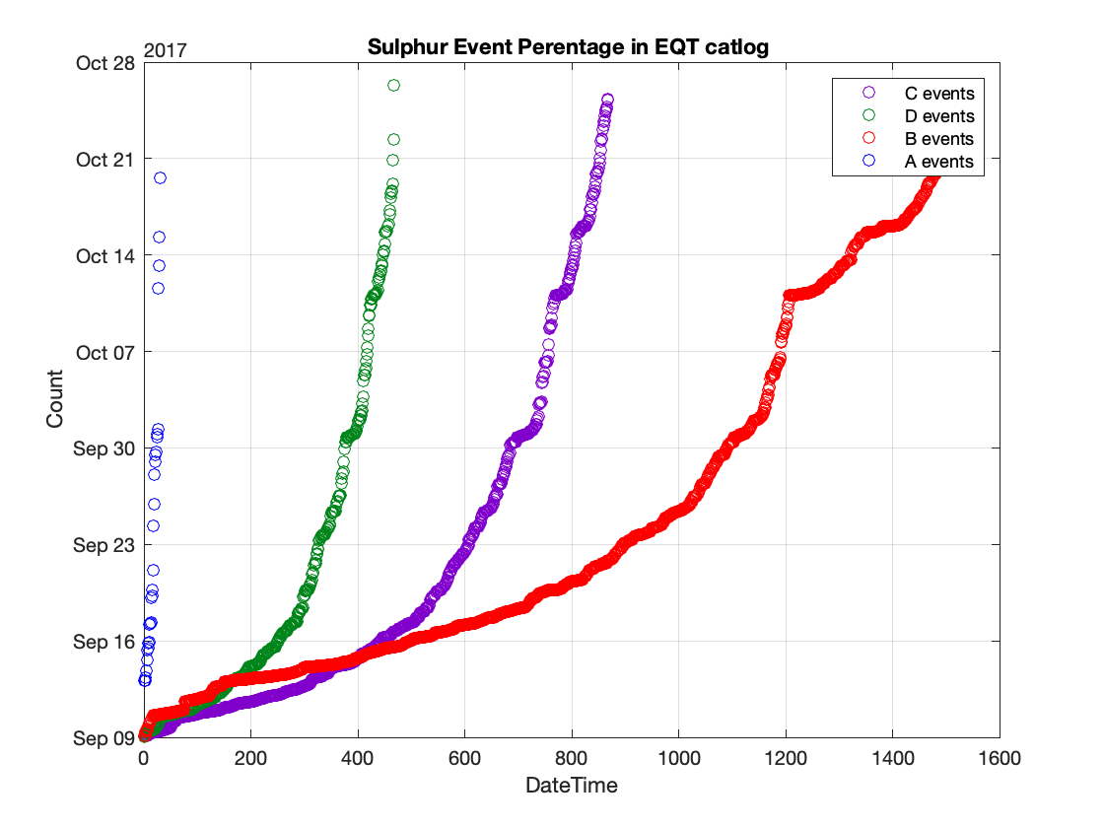
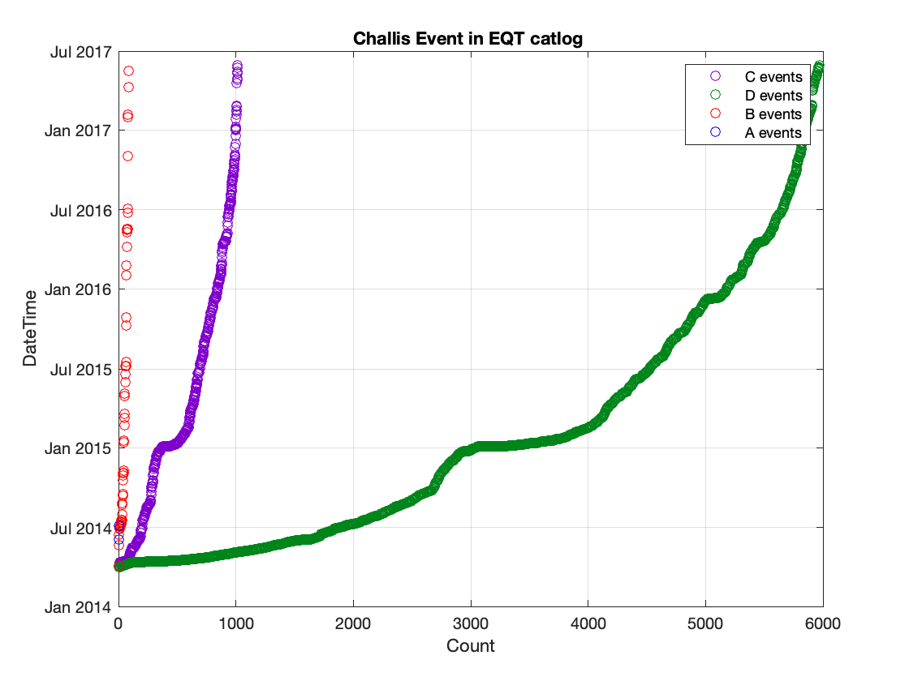
Quality Assessment from Hypoinverse

Slide 11
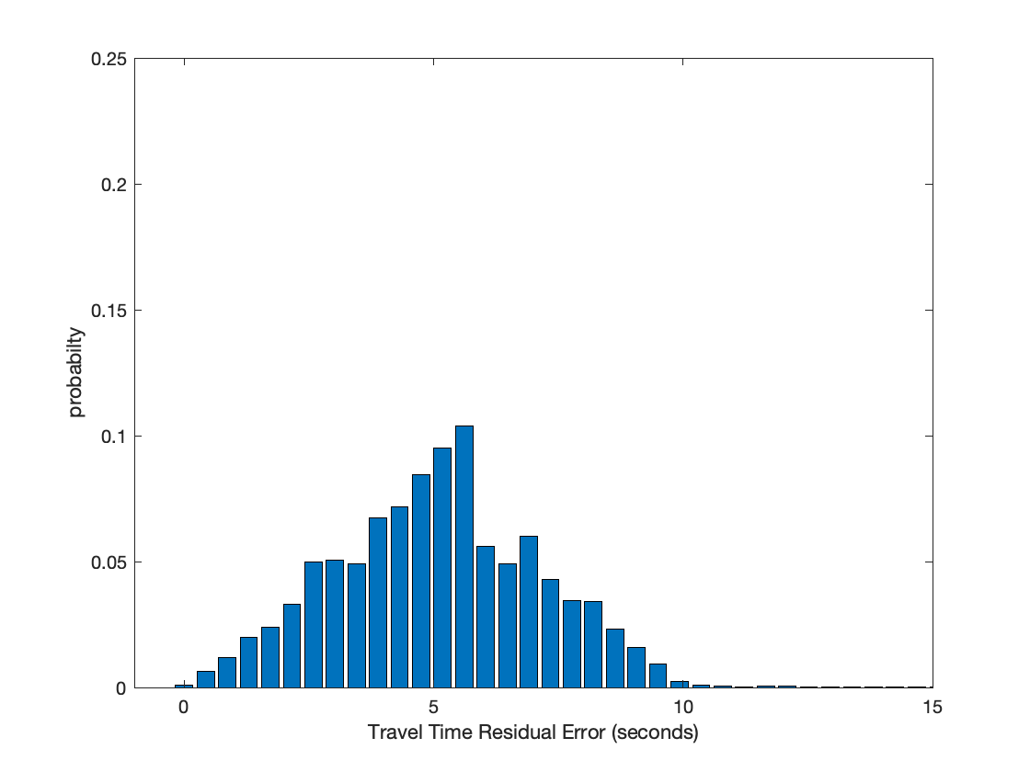
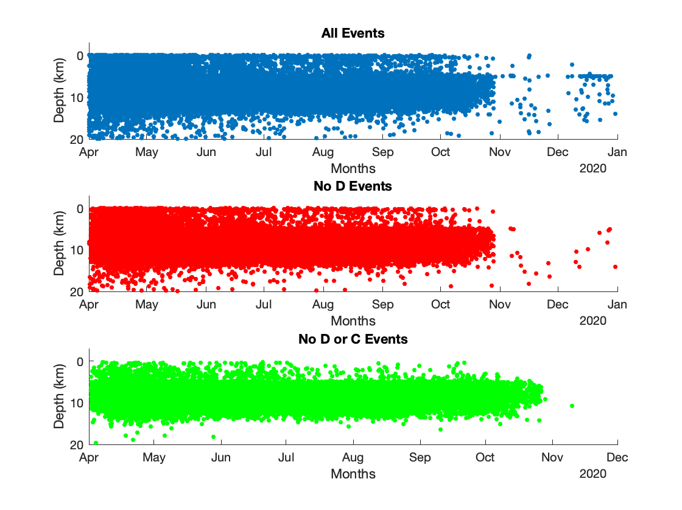
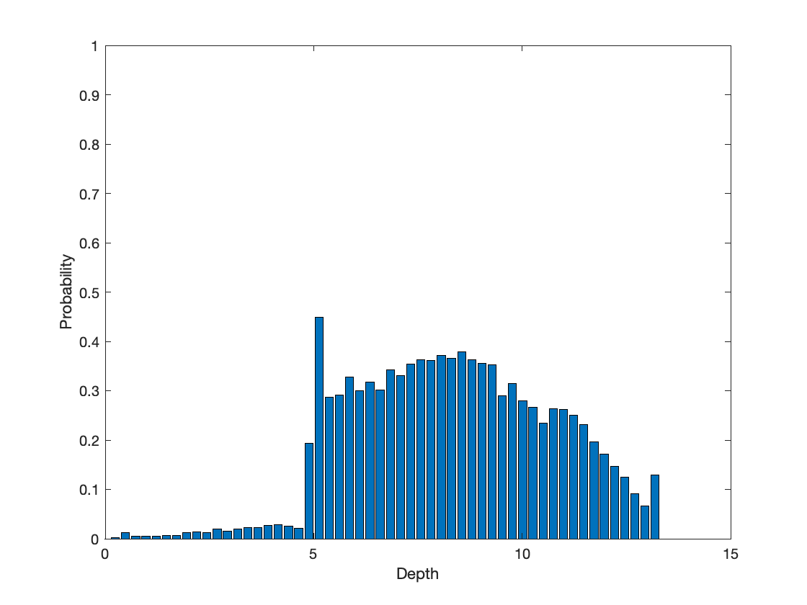
Stanley Sequence

Slide 12
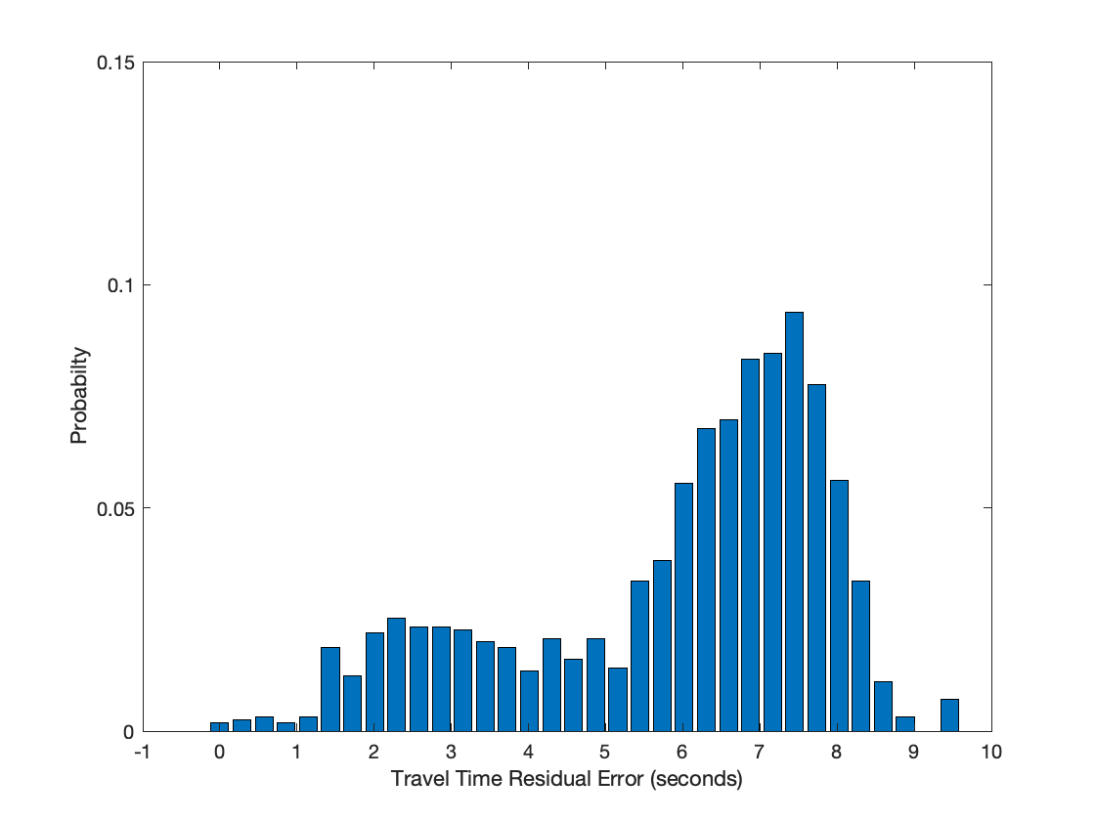
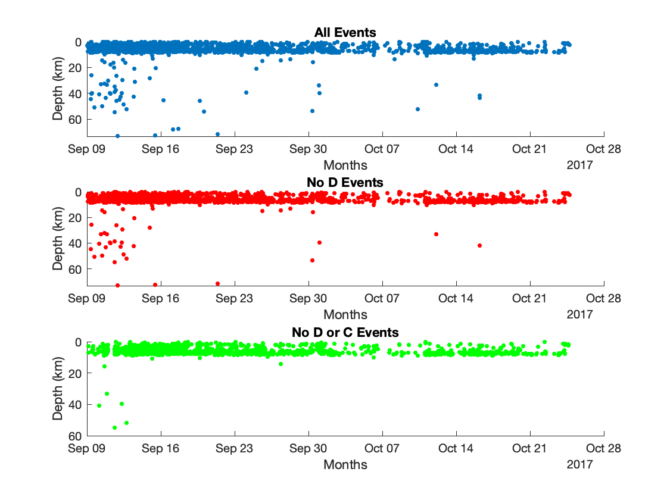
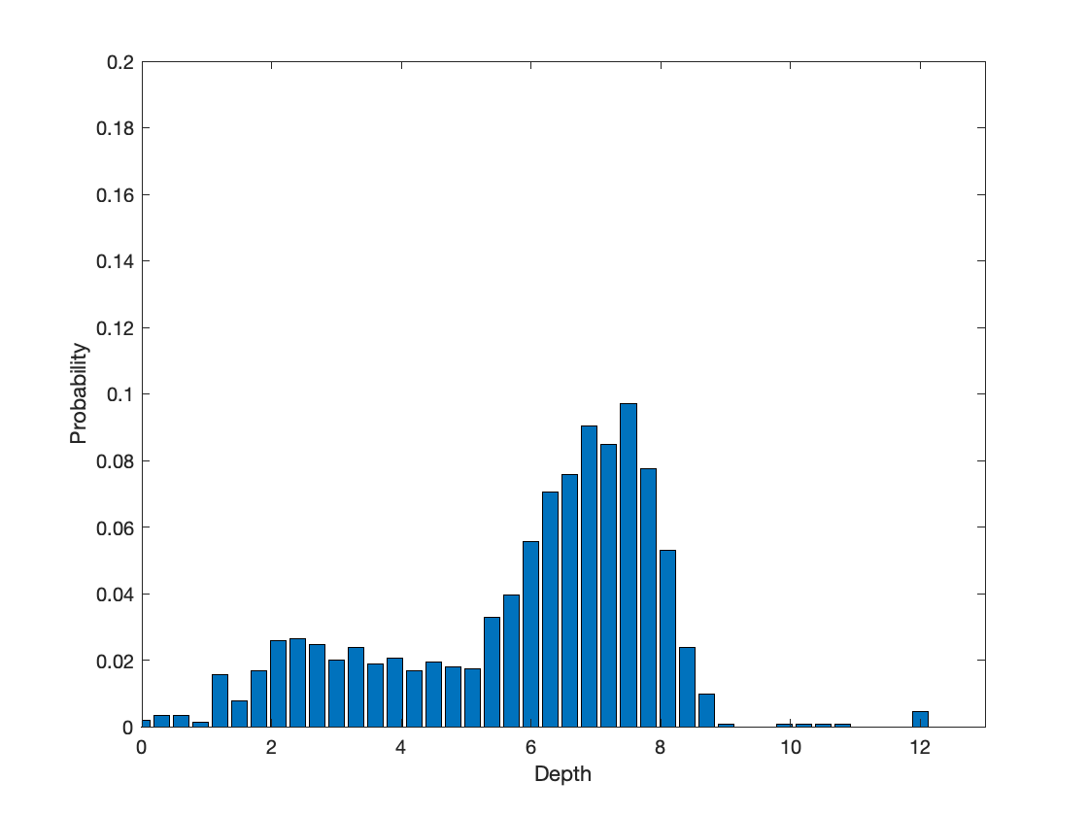
Sulphur Sequence
Notes:
Talk about the depth of the seismogenic zone here compared to the depths from Stanley and explain the difference in the depth of the brittle to ductile transition zone due to the Yellowstone hotspot and Sulphur's geographic location

Slide 13
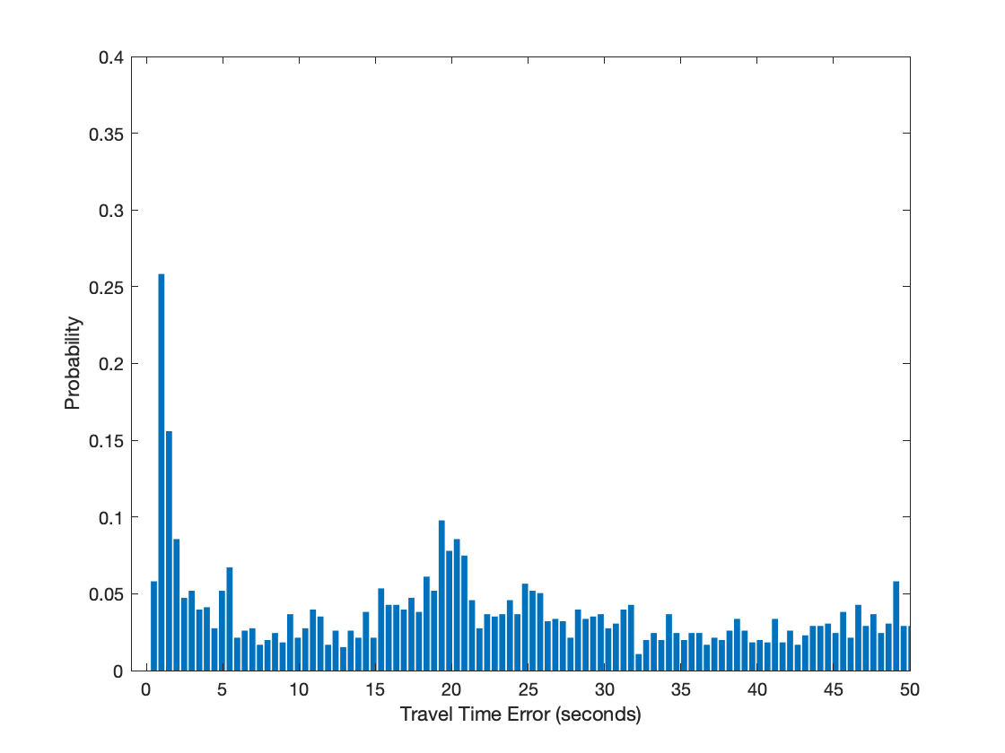
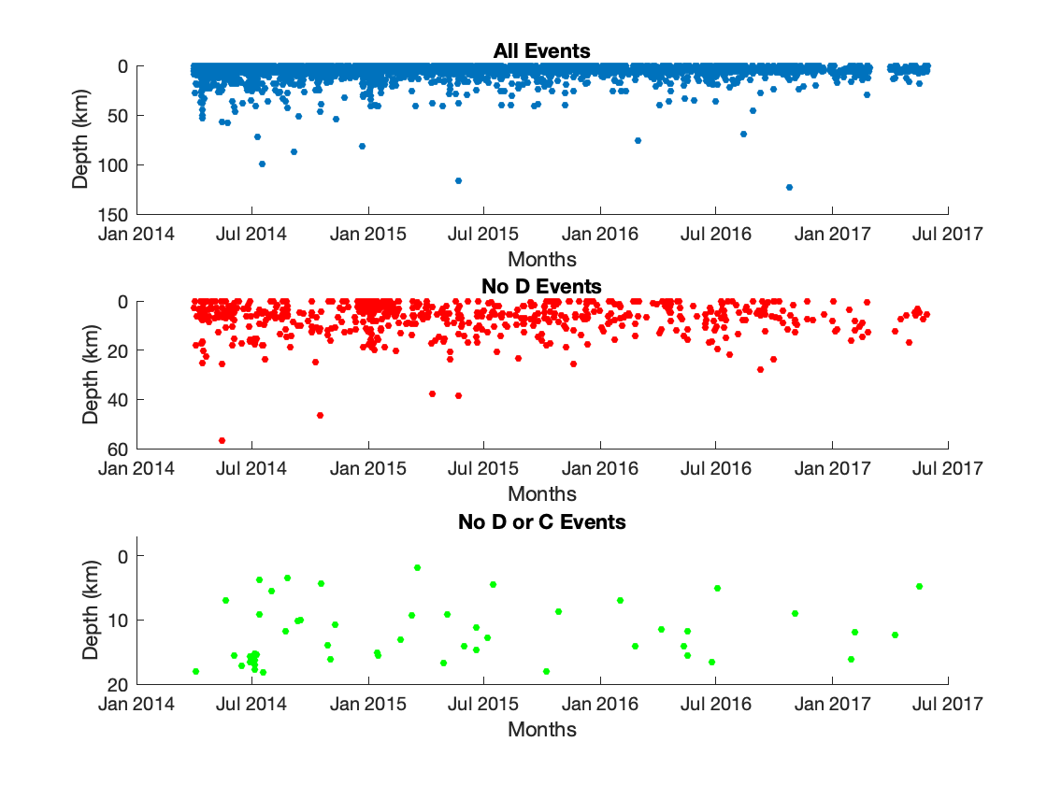
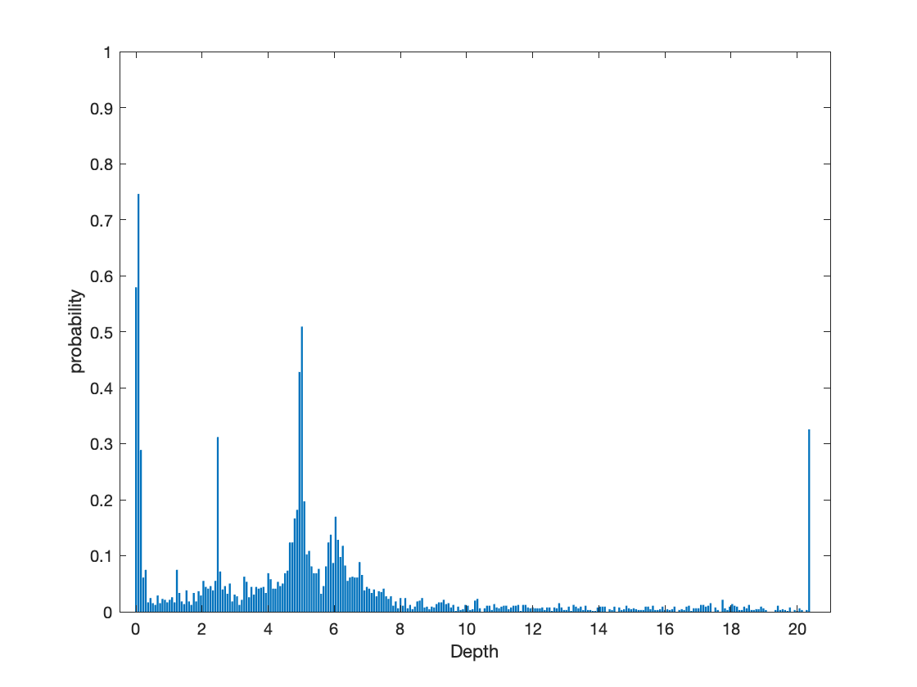
Challis Sequence

Slide 14
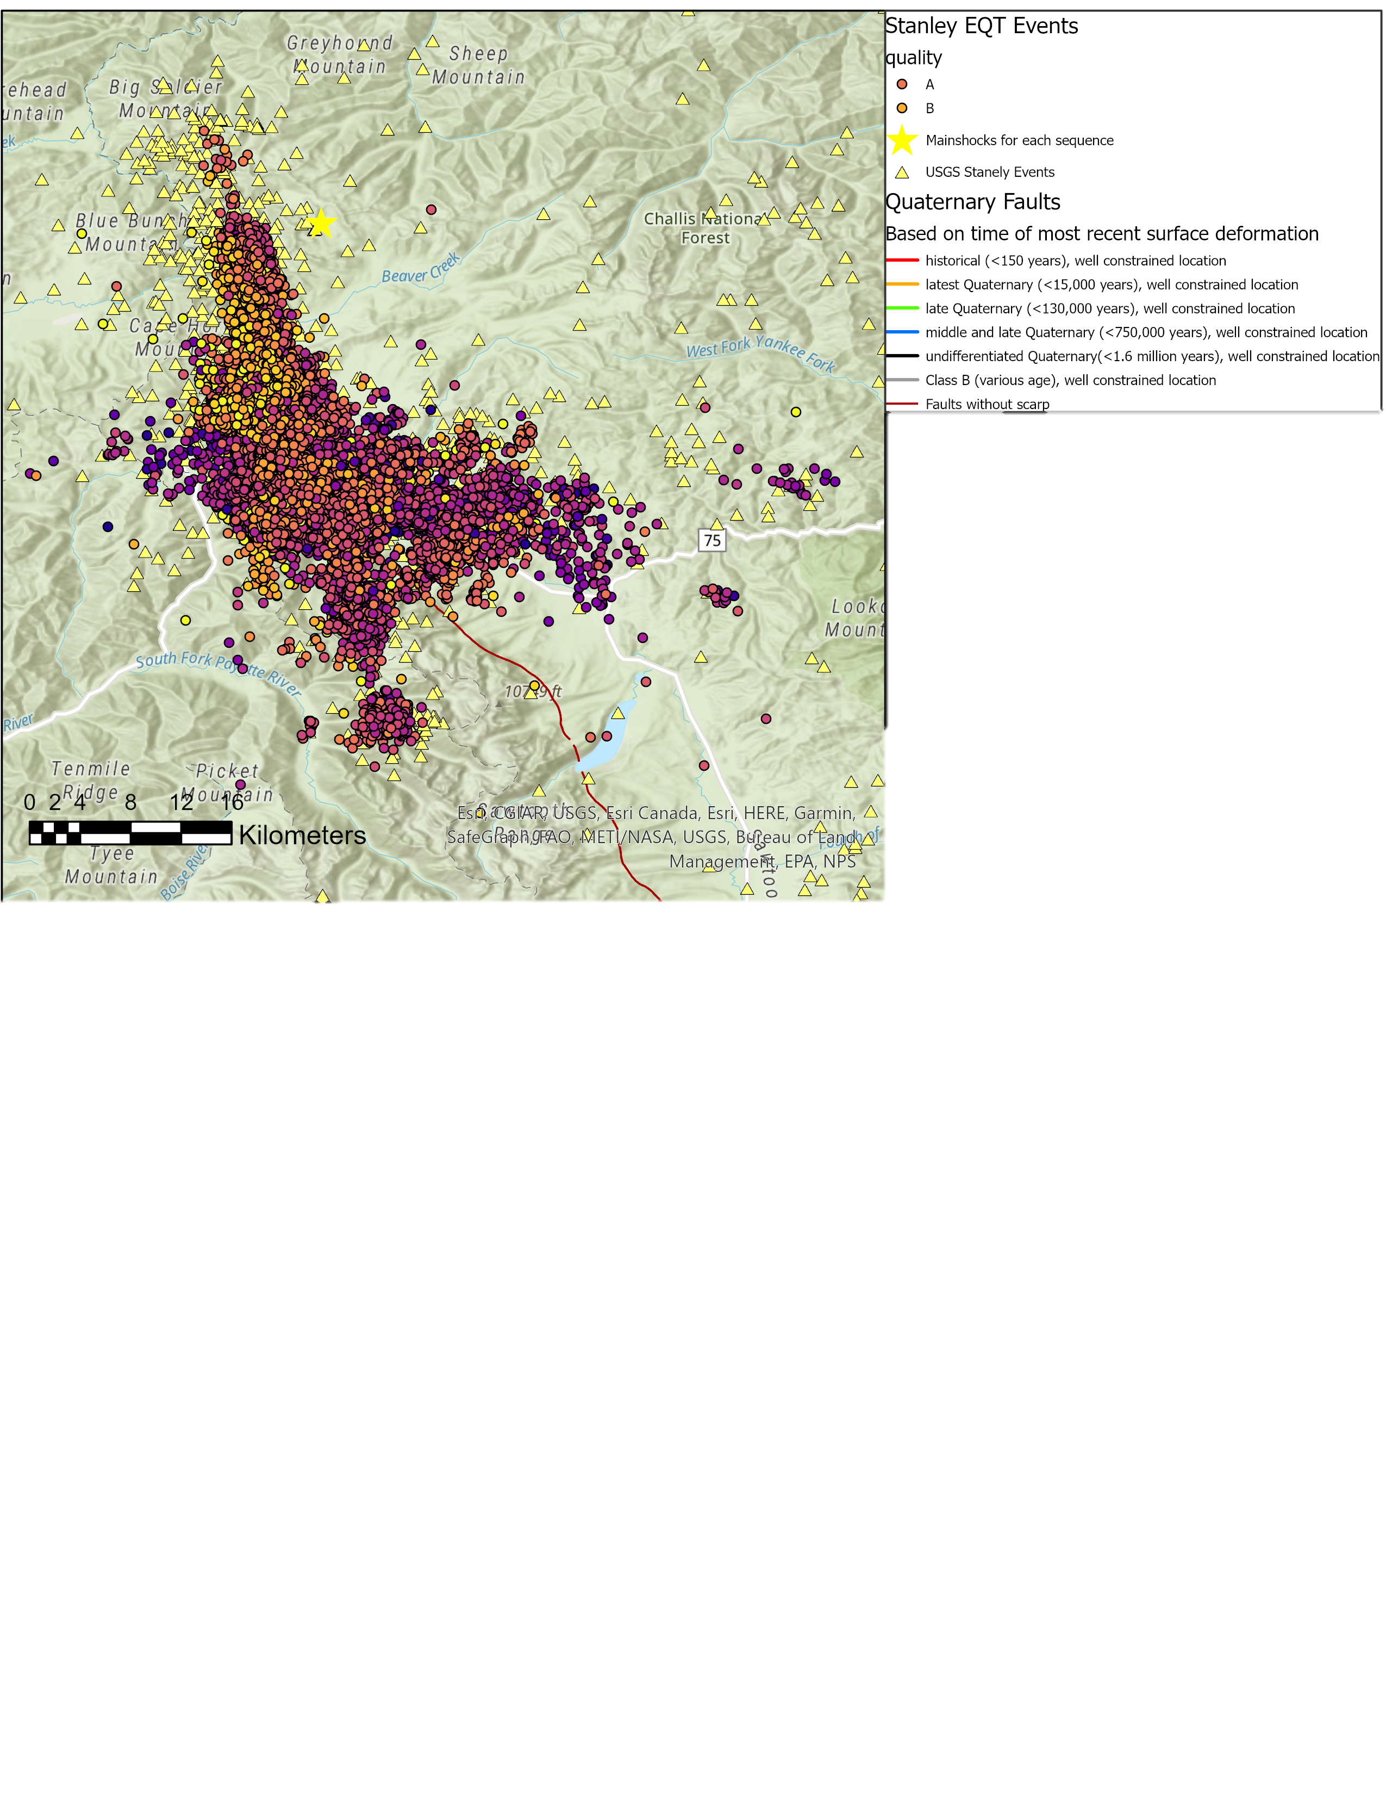
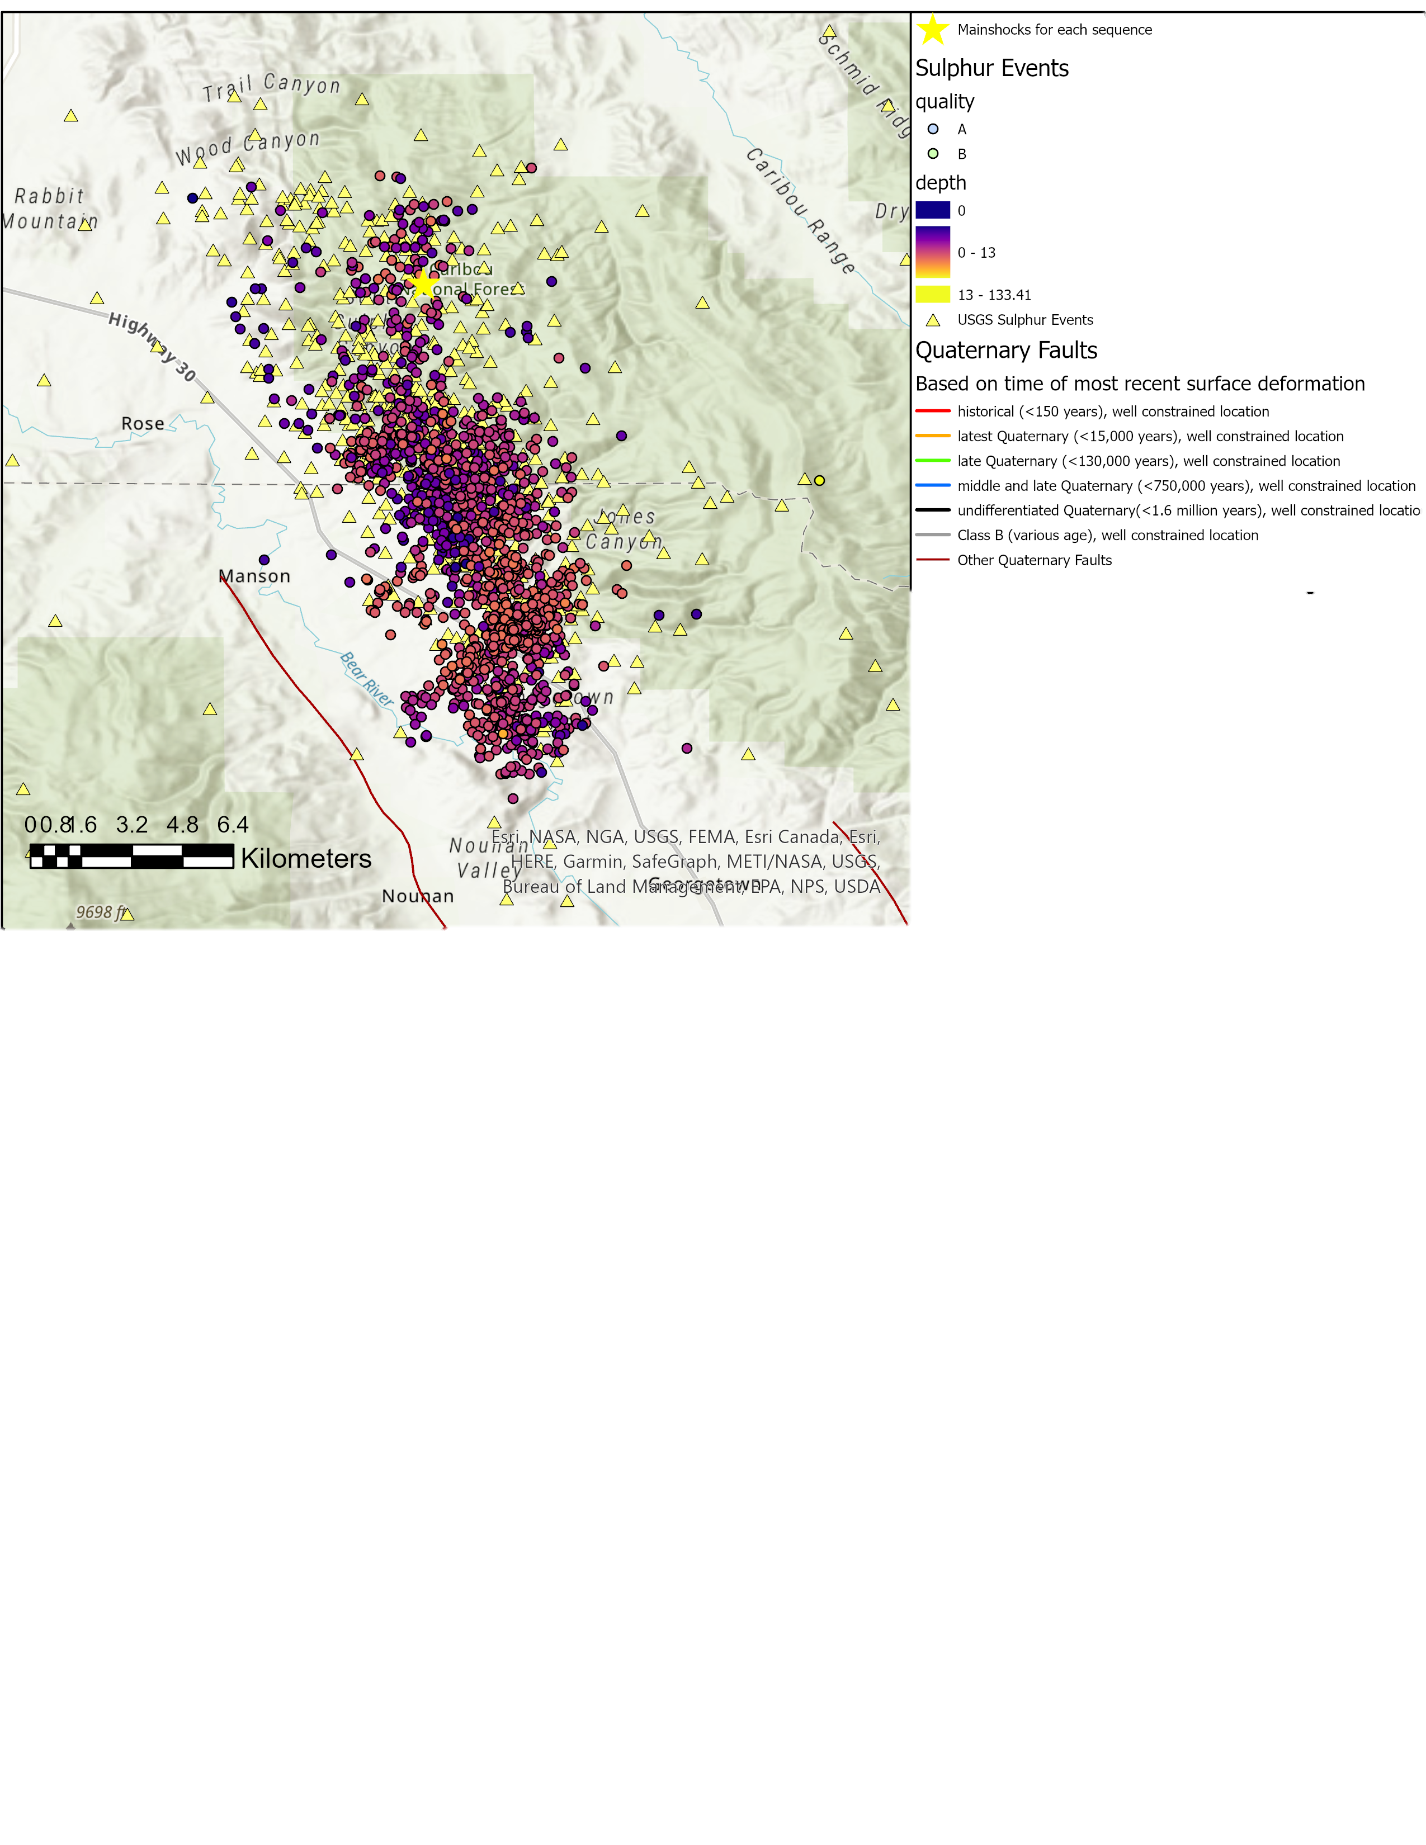
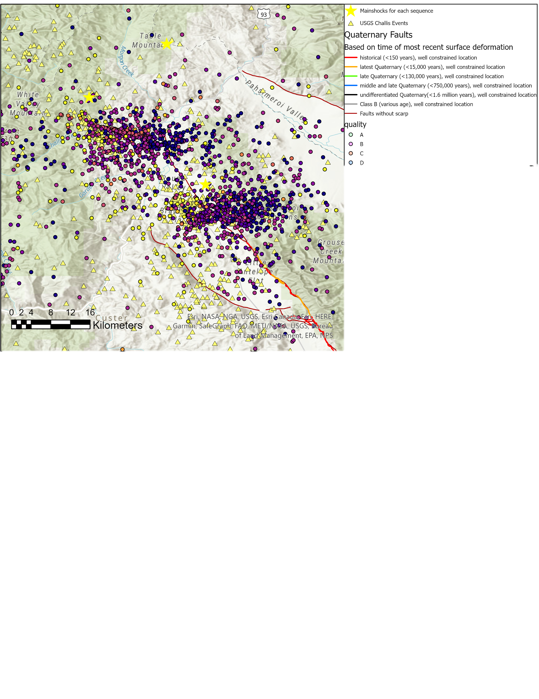
The Stanley and Sulphur Sequence provided the largest quantity of A’ and B’s as seen on the map
The map of Challis to the left show A’s, B’s, C’s and D’s due to the poor residuals and that 80% of the data were determined to be D’s.
May be possible to improve upon these preliminary results by using an inverted velocity model
Notes:
Talk about the change in dip direction of the Sawtooth fault, possible conjugate faulting, and how using the AK-135 velocity model tended to project the hypocenters at greater depths due to the default depth parameters chosen by the USGS.

Slide 15
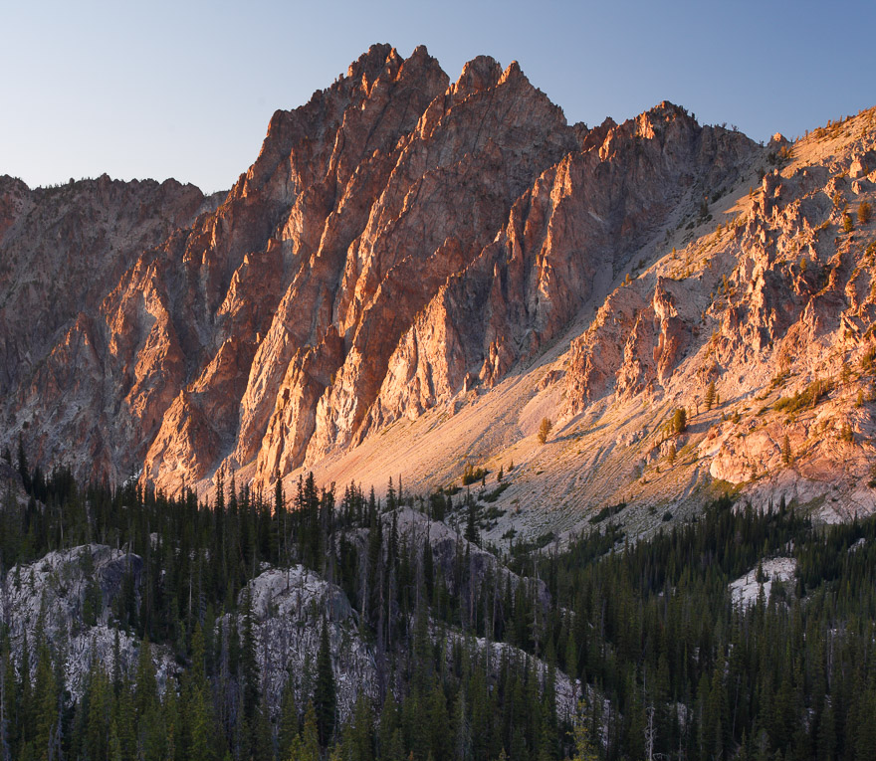
Moving Forward….
The next step is to determine whether a different velocity model for Challis could improve the quality of our picks.
Apart from the velocity model, I intend to use the data we have currently, and filter events based on vertical and horizontal error and the travel time residual.
Notes:
Need a third bullet. Think back to your unknowns/questions. What are you going to address specifically about those unknowns? You need to tie that in here.

Slide 16
References
Dewey, J. W. (1987). Instrumental Seismicity of Central Idaho et a1., 1985). 1. June, 819–836.
Crotwell, H. P., Owens, T. J., & Ritsema, J. (1999). The TauP Too ~ kit : Flexib / e Seismic Travel-time and Ray-path Utilities. 70(April), 154–160.
Liberty, L. M., Lifton, Z. M., & Dylan Mikesell, T. (2021). The 31 March 2020 Mw 6.5 Stanley, Idaho, earthquake: Seismotectonics and preliminary aftershock analysis. Seismological Research Letters, 92(2), 663–678. https://doi.org/10.1785/0220200319
Geiger, L. (1912). Probability method for the determination of earthquake epicenters from the arrival time only. Bulletin ofSaint Louis University, 8, 60–71
Kennett B.L.N., E.R. Engdahl and R. Buland. 1995. “Constraints on seismic velocities in the earth from travel times” Geophys. J. Int. 122, 108–124. https://doi.org/10.1111/j.1365-246X.1995.tb03540.x
Koper, K. D., Pankow, K. L., Pechmann, J. C., Hale, J. M., Burlacu, R., Yeck, W. L., Benz, H. M., Herrmann, R. B., Trugman, D. T., & Shearer, P. M. (2018). Afterslip Enhanced Aftershock Activity During the 2017 Earthquake Sequence Near Sulphur Peak, Idaho. Geophysical Research Letters, 45(11), 5352–5361. https://doi.org/10.1029/2018GL078196
Mosher, S. G., & Audet, P. (2020). Automatic Detection and Location of Seismic Events From Time-Delay Projection Mapping and Neural Network Classification. Journal of Geophysical Research: Solid Earth, 125(10), 1–18. https://doi.org/10.1029/2020JB019426
Mousavi, S. M., Ellsworth, W. L., Zhu, W., Chuang, L. Y., & Beroza, G. C. (2020). Earthquake transformer—an attentive deep-learning model for simultaneous earthquake detection and phase picking. Nature Communications, 11(1). https://doi.org/10.1038/s41467-020-17591-w
Pang, G., Koper, K. D., Stickney, M. C., Pechmann, J. C., Burlacu, R., Pankow, K. L., Payne, S., & Benz, H. M. (2018). Seismicity in the Challis, Idaho, Region, January 2014-May 2017: Late aftershocks of the 1983 Ms 7.3 Borah Peak Earthquake. Seismological Research Letters, 89(4), 1366–1378. https://doi.org/10.1785/0220180058
Payne, S. J., McCaffrey, R., & Kattenhorn, S. A. (2013). Extension-driven right-lateral shear in the centennial shear zone adjacent to the eastern snake river plain, Idaho. Lithosphere, 5(4), 407–419. https://doi.org/10.1130/L200.1
Pollitz, F. F., Hammond, W. C., & Wicks, C. W. (2021). Rupture process of the M 6.5 Stanley, Idaho, earthquake inferred from seismic waveform and geodetic data. Seismological Research Letters, 92(2 A), 699–709. https://doi.org/10.1785/0220200315
Thackray, G. D., Rodgers, D. W., & Streutker, D. (2013). Holocene scarp on the sawtooth fault, central Idaho, USA, documented through lidar topographic analysis. Geology, 41(6), 639–642. https://doi.org/10.1130/G34095.1
Trabant, C., A. R. Hutko, M. Bahavar, R. Karstens, T. Ahern, and R. Aster (2012), Data Products at the IRIS DMC: Stepping Stones for Research and Other Applications, Seismological Research Letters, 83(5), 846–854, https://doi.org/10.1785/0220120032.

